Slide 1
COMP9024: Data Structures and Algorithms
Week Six: Search Trees
Hui Wu
Session 2, 2015
http://www.cse.unsw.edu.au/~cs9024

Slide 2
Outline
Binary Search Trees
AVL Trees
Splay Trees
(2,4) Trees
Red-Black Trees

Slide 3
Binary Search Trees
<
6
2
>
9
1
4
=
8

Slide 4

Ordered Dictionaries
Keys are assumed to come from a total order.
New operations:
  first(): first entry in the dictionary ordering
  last(): last entry in the dictionary ordering
  successors(k): iterator of entries with keys greater than or equal to k; increasing order
  predecessors(k): iterator of entries with keys less than or equal to k; decreasing order

Slide 5

Binary Search
Binary search can perform operation find(k) on a dictionary implemented by means of an array-based sequence, sorted by key
  similar to the high-low game
  at each step, the number of candidate items is halved
  terminates after O(log n) steps
Example: find(7)
0
1
3
4
5
7
8
9
11
14
16
18
19
l
m
h
0
1
3
4
5
7
8
9
11
14
16
18
19
l
m
h
0
1
3
4
5
7
8
9
11
14
16
18
19
l
m
h
0
1
3
4
5
7
8
9
11
14
16
18
19
l=m =h

Slide 6

Search Tables
A search table is a dictionary implemented by means of a sorted sequence
  We store the items of the dictionary in an array-based sequence, sorted by key
  We use an external comparator for the keys
Performance:
  find takes O(log n) time, using binary search
  insert takes O(n) time since in the worst case we have to shift n/2 items to make room for the new item
  remove take O(n) time since in the worst case we have to shift n/2 items to compact the items after the removal
The lookup table is effective only for dictionaries of small size or for dictionaries on which searches are the most common operations, while insertions and removals are rarely performed (e.g., credit card authorizations)

Slide 7
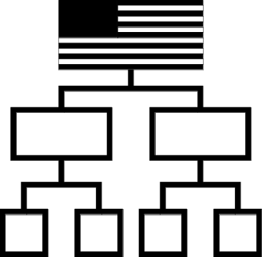
Binary Search Trees
A binary search tree is a binary tree storing keys (or key-value entries) at its internal nodes and satisfying the following property:
  Let u, v, and w be three nodes such that u is in the left subtree of v and w is in the right subtree of v. We have
  key(u) ≤ key(v) ≤ key(w)
External nodes do not store items
An inorder traversal of a binary search trees visits the keys in increasing order
6
2
9
1
4
8

Slide 8
Search
To search for a key k, we trace a downward path starting at the root
The next node visited depends on the outcome of the comparison of k with the key of the current node
If we reach a leaf, the key is not found and we return null
Example: find(4):
  Call TreeSearch(4,root)
Algorithm TreeSearch(k, v)
{ if ( T.isExternal (v) )
  return v ;
  if ( k < key(v) )
  return TreeSearch(k, T.left(v));
  else if ( k = key(v) )
  return v ;
  else // k > key(v)
  return TreeSearch(k, T.right(v)) ; }
<
6
2
>
9
1
4
=
8

Slide 9
Insertion
<
6
To perform operation insert(k, o), we search for key k (using TreeSearch)
Assume k is not already in the tree, and let let w be the leaf reached by the search
We insert k at node w and expand w into an internal node
Example: insert 5
2
>
9
1
4
>
8
w
6
2
9
1
4
8
w
5

Slide 10
Deletion (1/2)
To perform operation remove(k), we search for key k
Assume key k is in the tree, and let let v be the node storing k
If node v has a leaf child w, we remove v and w from the tree with operation removeExternal(w), which removes w and its parent
Example: remove 4
<
6
2
>
9
1
4
v
8
w
5
6
2
9
1
5
8

Slide 11
Deletion (2/2)
1
v
We consider the case where the key k to be removed is stored at a node v whose children are both internal
  we find the internal node w that follows v in an inorder traversal
  we copy key(w) into node v
  we remove node w and its left child z (which must be a leaf) by means of operation removeExternal(z)
Example: remove 3
3
2
8
6
9
w
5
z
1
v
5
2
8
6
9

Slide 12
Performance
Consider a dictionary with n items implemented by means of a binary search tree of height h
  the space used is O(n)
  methods find, insert and remove take O(h) time
The height h is O(n) in the worst case and O(log n) in the best case

Slide 13
AVL Trees
6
v
3
8
z
4

Slide 14
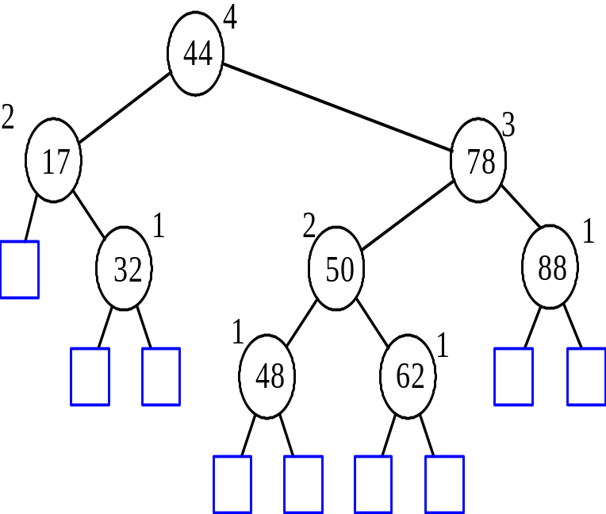
AVL Tree Definition
AVL trees are balanced.
An AVL Tree is a binary search tree such that for every internal node v of T, the heights of the children of v can differ by at most 1.
An example of an AVL tree where the heights are shown next to the nodes:

Slide 15
Height of an AVL Tree
n(2)
3
4
n(1)
Fact: The height of an AVL tree storing n keys is O(log n).
Proof: Let us bound n(h): the minimum number of internal nodes of an AVL tree of height h.
We easily see that n(1) = 1 and n(2) = 2
For n > 2, an AVL tree of height h contains the root node, one AVL subtree of height h-1 and another of height h-2.
That is, n(h) = 1 + n(h-1) + n(h-2)
Knowing n(h-1) > n(h-2), we get n(h) > 2n(h-2). So
  n(h) > 2n(h-2), n(h) > 4n(h-4), n(h) > 8n(n-6), … (by induction),
  n(h) > 2^{i}n(h-2i)
Solving the base case we get: n(h) > 2 ^{h/2-1}
Taking logarithms: h < 2log n(h) +2
Thus the height of an AVL tree is O(log n)

Slide 16
Insertion in an AVL Tree
Insertion is as in a binary search tree
Always done by expanding an external node.
Example:
44
44
17
78
17
78
c=z
a=y
32
50
88
32
50
88
48
62
48
62
b=x
54
w
before insertion
after insertion

Slide 17
Trinode Restructuring
let (a,b,c) be an inorder listing of x, y, z
perform the rotations needed to make b the topmost node of the three
(other two cases are symmetrical)
a=z
a=z
case 2: double rotation
(a right rotation about c, then a left rotation about a)
T₀
T₀
c=y
b=y
T₁
b=x
T₃
c=x
T₂
T₃
b=y
T₁
T₂
b=x
a=z
c=x
a=z
c=y
case 1: single rotation
(a left rotation about a)
T₀
T₁
T₂
T₃
T₀
T₁
T₂
T₃

Slide 18
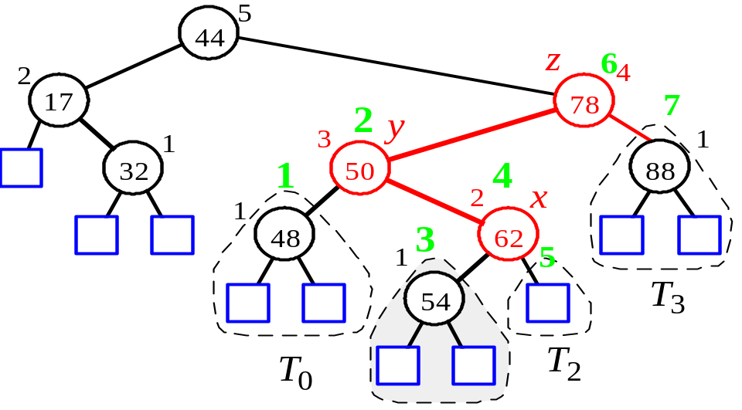
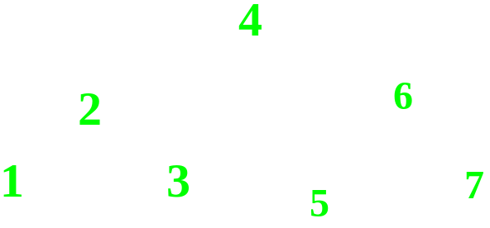
Insertion Example, continued
unbalanced...
T
4
1
44
2
3
x
17
y
62
z
1
2
2
32
50
78
1
1
1
...balanced
48
54
88
T
2
T
0
T
1
T
3

Slide 19
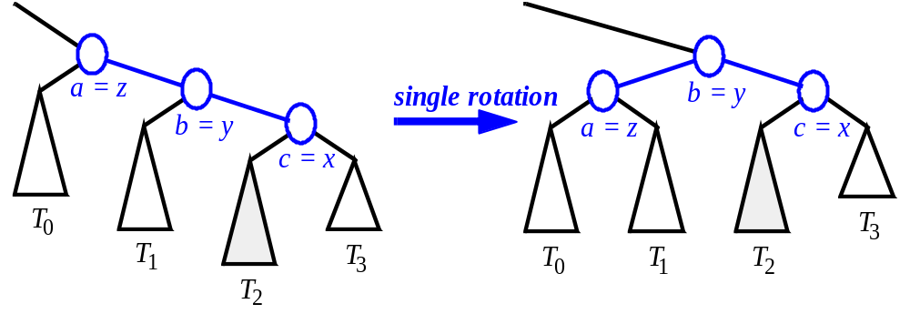
Restructuring(as Single Rotations)
Single Rotations:
c = z
single rotation
b = y
b = y
a = x
c = z
a = x
T
3
T
T
T
0
T
T
T
0
2
1
2
3
T
1

Slide 20
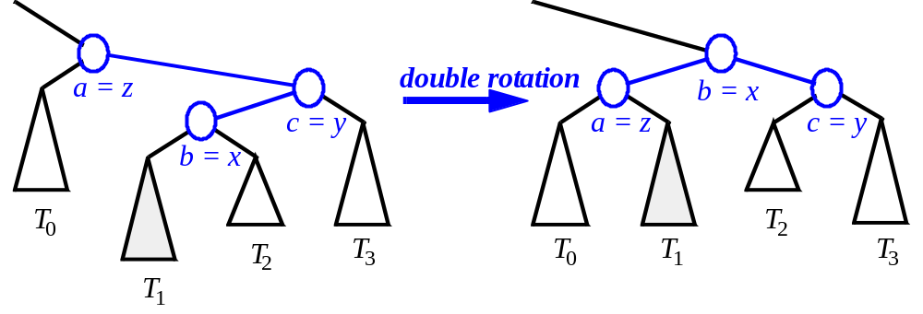
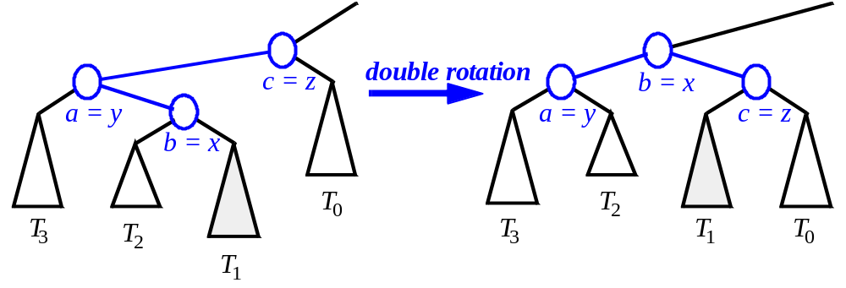
Restructuring(as Double Rotations)
double rotations:

Slide 21
Removal in an AVL Tree
Removal begins as in a binary search tree, which means the node removed will become an empty external node. Its parent, w, may cause an imbalance.
Example:
44
44
17
62
17
62
32
50
78
50
78
48
54
88
48
54
88
before deletion of 32
after deletion

Slide 22
Rebalancing after a Removal
Let z be the first unbalanced node encountered while travelling up the tree from w. Also, let y be the child of z with the larger height, and let x be the child of y with the larger height.
We perform restructure(x) to restore balance at z.
As this restructuring may upset the balance of another node higher in the tree, we must continue checking for balance until the root of T is reached
62
a=z
44
44
78
w
17
62
b=y
17
50
88
50
78
c=x
48
54
48
54
88

Slide 23

Running Times for AVL Trees
a single restructure is O(1)
  using a linked-structure binary tree
find is O(log n)
  height of tree is O(log n), no restructures needed
insert is O(log n)
  initial find is O(log n)
  Restructuring up the tree, maintaining heights is O(log n)
remove is O(log n)
  initial find is O(log n)
  Restructuring up the tree, maintaining heights is O(log n)

Slide 24
Splay Trees
6
v
3
8
z
4

Slide 25
Splay Trees are Binary Search Trees
(20,Z)
all the keys in the blue region are ≥ 20
note that two keys of equal value may be well-separated
(10,A)
(35,R)
BST Rules:
  entries stored only at internal nodes
  keys stored at nodes in the left subtree of v are less than or equal to the key stored at v
  keys stored at nodes in the right subtree of v are greater than or equal to the key stored at v
An inorder traversal will return the keys in order
(7,T)
(14,J)
(21,O)
(37,P)
(1,Q)
(8,N)
(36,L)
(40,X)
(1,C)
(5,H)
(7,P)
(10,U)
(2,R)
(5,G)
all the keys in the yellow region are ≤ 20
(5,I)
(6,Y)

Slide 26
Searching in a Splay Tree: Starts the Same as in a BST
(20,Z)
Search proceeds down the tree to find item or an external node.
Example: Search for an item with key 11.
(10,A)
(35,R)
(7,T)
(14,J)
(21,O)
(37,P)
(1,Q)
(8,N)
(36,L)
(40,X)
(1,C)
(5,H)
(7,P)
(10,U)
(2,R)
(5,G)
(5,I)
(6,Y)

Slide 27
Example Searching in a BST, continued
(20,Z)
search for key 8, ends at an internal node.
(10,A)
(35,R)
(7,T)
(14,J)
(21,O)
(37,P)
(1,Q)
(8,N)
(36,L)
(40,X)
(1,C)
(5,H)
(7,P)
(10,U)
(2,R)
(5,G)
(5,I)
(6,Y)

Slide 28
Splay Trees do Rotations after Every Operation (Even Search)
new operation: splay
  splaying moves a node to the root using rotations
right rotation
  makes the left child x of a node y into y’s parent; y becomes the right child of x
left rotation
  makes the right child y of a node x into x’s parent; x becomes the left child of y
y
x
a right rotation about y
a left rotation about x
x
T₃
T₁
y
x
y
T₁
T₂
T₁
T₂
T₃
y
x
T₃
T₂
T₃
T₁
T₂
(structure of tree above y is not modified)
(structure of tree above x is not modified)

Slide 29
Splaying:
“x is a left-left grandchild” means x is a left child of its parent, which is itself a left child of its parent
p is x’s parent; g is p’s parent
start with node x
is x a left-left grandchild?
is x the root?
yes
zig-zig
stop
yes
right-rotate about g, right-rotate about p
no
is x a right-right grandchild?
is x a child of the root?
zig-zig
no
yes
left-rotate about g, left-rotate about p
yes
is x a right-left grandchild?
is x the left child of the root?
zig-zag
no
yes
left-rotate about p, right-rotate about g
is x a left-right grandchild?
zig
zig
zig-zag
yes
right-rotate about the root
left-rotate about the root
yes
right-rotate about p, left-rotate about g

Slide 30
Visualizing the Splaying Cases
zig-zag
x
z
z
T₄
y
z
y
T₁
y
T₄
T₁
T₂
T₃
T₄
T₃
x
x
T₂
T₃
T₁
T₂
zig-zig
x
y
zig
T₁
T₄
x
y
x
T₂
z
T₃
w
y
w
T₃
T₄
T₁
T₂
T₃
T₄
T₁
T₂

Slide 31
Splaying Example
(20,Z)
(10,A)
(35,R)
let x = (8,N)
  x is the right child of its parent, which is the left child of the grandparent
  left-rotate around p, then right-rotate around g
g
1.
(before rotating)
p
(7,T)
(14,J)
(21,O)
(37,P)
(1,Q)
(8,N)
(36,L)
(40,X)
x
(1,C)
(5,H)
(7,P)
(10,U)
(2,R)
(5,G)
(20,Z)
(5,I)
(6,Y)
g
(10,A)
(35,R)
(20,Z)
x
(8,N)
(14,J)
(21,O)
(37,P)
x
(8,N)
(35,R)
g
p
(7,T)
(10,U)
(36,L)
(40,X)
p
(7,T)
(10,A)
(21,O)
(37,P)
(1,Q)
(7,P)
(1,Q)
(7,P)
(14,J)
(36,L)
(40,X)
2.
(after first rotation)
(1,C)
(5,H)
(1,C)
(5,H)
(10,U)
3.
(after second rotation)
(2,R)
(5,G)
(2,R)
(5,G)
(5,I)
(6,Y)
(5,I)
(6,Y)
x is not yet the root, so we splay again

Slide 32
Splaying Example, Continued
now x is the left child of the root
  right-rotate around root
(20,Z)
x
(8,N)
(35,R)
(7,T)
(10,A)
(21,O)
(37,P)
(1,Q)
(7,P)
(14,J)
(36,L)
(40,X)
(8,N)
x
2.
(after rotation)
(1,C)
(5,H)
(10,U)
1.
(before applying rotation)
(7,T)
(20,Z)
(2,R)
(5,G)
(1,Q)
(7,P)
(10,A)
(35,R)
(5,I)
(6,Y)
(1,C)
(5,H)
(14,J)
(21,O)
(37,P)
(2,R)
(5,G)
(10,U)
(36,L)
(40,X)
(5,I)
(6,Y)
x is the root, so stop

Slide 33
Example Result of Splaying
(20,Z)
(10,A)
(35,R)
before
(7,T)
(14,J)
(21,O)
(37,P)
tree might not be more balanced
e.g. splay (40,X)
  before, the depth of the shallowest leaf is 3 and the deepest is 7
  after, the depth of shallowest leaf is 1 and deepest is 8
(1,Q)
(8,N)
(36,L)
(40,X)
(1,C)
(5,H)
(7,P)
(10,U)
(2,R)
(5,G)
(40,X)
(5,I)
(6,Y)
(20,Z)
(20,Z)
(10,A)
(40,X)
(10,A)
(37,P)
(14,J)
(37,P)
(7,T)
(14,J)
(35,R)
(7,T)
(1,Q)
(8,N)
(35,R)
(1,Q)
(8,N)
(21,O)
(36,L)
(1,C)
(10,U)
(21,O)
(36,L)
(1,C)
(5,H)
(7,P)
(10,U)
(5,H)
(7,P)
(2,R)
(5,G)
(2,R)
(5,G)
after first splay
after second splay
(6,Y)
(5,I)
(6,Y)
(5,I)

Slide 34

Splay Tree Definition
a splay tree is a binary search tree where a node is splayed after it is accessed (for a search or update)
  deepest internal node accessed is splayed
  splaying costs O(h),where h is height of the tree – which is still O(n) worst-case
    O(h) rotations, each of which is O(1)

Slide 35

Splay Trees & Ordered Dictionaries
which nodes are splayed after each operation?
method
splay node
if key found, use that node
if key not found, use parent of ending external node
find(k)
insert(k,v)
use the new node containing the entry inserted
use the parent of the internal node that was actually removed from the tree (the parent of the node that the removed item was swapped with)
remove(k)

Slide 36
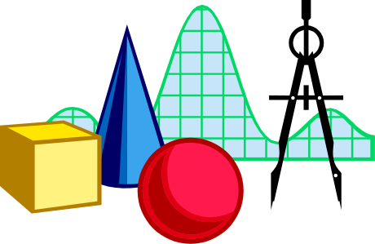
Amortized Analysis of Splay Trees
Running time of each operation is proportional to time for splaying.
Define rank(v) as the logarithm (base 2) of the number of nodes in subtree rooted at v.
Costs: zig = $1, zig-zig = $2, zig-zag = $2.
Thus, cost for splaying a node at depth d = $d.
Imagine that we store rank(v) & cyber-dollars at each node v of the splay tree (just for the sake of analysis).

Slide 37

Cost per zig
y
zig
T₄
x
x
T₃
w
y
w
T₁
T₂
T₃
T₄
T₁
T₂
Doing a zig at x costs at most rank’(x) - rank(x):
  cost = rank’(x) + rank’(y) - rank(y) - rank(x) < rank’(x) - rank(x).

Slide 38
Cost per zig-zig and zig-zag
z
T₄
T₁
x
y
T₃
zig-zig
y
T₂
T₁
x
T₂
z
T₃
T₄
Doing a zig-zig or zig-zag at x costs at most 3(rank’(x) - rank(x)) - 2.
  Proof: See Proposition 9.2, Page 440.
z
zig-zag
x
T₁
y
z
y
T₄
T₁
T₂
T₃
T₄
x
T₂
T₃

Slide 39
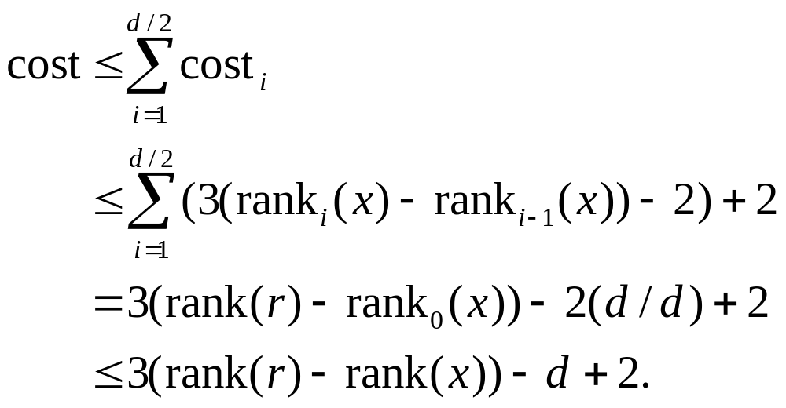
Cost of Splaying
Cost of splaying a node x at depth d of a tree rooted at r:
  at most 3(rank(r) - rank(x)) - d + 2:
  Proof: Splaying x takes d/2 splaying substeps:

Slide 40

Performance of Splay Trees
Recall: rank of a node is logarithm of its size.
Thus, amortized cost of any splay operation is O(log n).
In fact, the analysis goes through for any reasonable definition of rank(x).
This implies that splay trees can actually adapt to perform searches on frequently-requested items much faster than O(log n) in some cases. (See Proposition 10.6.)

Slide 41
(2,4) Trees
9
2 5 7
10 14

Slide 42
Multi-Way Search Tree
A multi-way search tree is an ordered tree such that
  Each internal node has at least two children and stores d −1 key-element items (k_{i}, o_{i}), where d is the number of children
  For a node with children v₁ v₂ … v_{d} storing keys k₁ k₂ … k_{d−1}
    keys in the subtree of v₁ are less than k₁
    keys in the subtree of v_{i} are between k_{i−1} and k_{i} (i = 2, …, d − 1)
    keys in the subtree of v_{d} are greater than k_{d−1}
  The leaves store no items and serve as placeholders
11 24
2 6 8
15
27 32
30

Slide 43
Multi-Way Inorder Traversal
We can extend the notion of inorder traversal from binary trees to multi-way search trees
Namely, we visit item (k_{i}, o_{i}) of node v between the recursive traversals of the subtrees of v rooted at children v_{i} and v_{i} ₊ ₁
An inorder traversal of a multi-way search tree visits the keys in increasing order
11 24
8
12
2 6 8
15
27 32
2
4
6
10
14
18
30
1
3
5
7
9
11
13
16
19
15
17

Slide 44
Multi-Way Searching
Similar to search in a binary search tree
A each internal node with children v₁ v₂ … v_{d} and keys k₁ k₂ … k_{d−1}
  k = k_{i} (i = 1, …, d − 1): the search terminates successfully
  k < k₁: we continue the search in child v₁
  k_{i−1} < k < k_{i} (i = 2, …, d − 1): we continue the search in child v_{i}
  k > k_{d−1}: we continue the search in child v_{d}
Reaching an external node terminates the search unsuccessfully
Example: search for 30
11 24
2 6 8
15
27 32
30

Slide 45
(2,4) Trees
A (2,4) tree (also called 2-4 tree or 2-3-4 tree) is a multi-way search with the following properties
  Node-Size Property: every internal node has at most four children
  Depth Property: all the external nodes have the same depth
Depending on the number of children, an internal node of a (2,4) tree is called a 2-node, 3-node or 4-node
10 15 24
2 8
12
18
27 32

Slide 46
Height of a (2,4) Tree
Theorem: A (2,4) tree storing n items has height O(log n)
Proof:
  Let h be the height of a (2,4) tree with n items
  Since there are at least 2^{i} items at depth i = 0, … , h − 1 and no items at depth h, we have
  n ≥ 1 + 2 + 4 + … + 2^{h−1} = 2^{h} − 1
  Thus, h ≤ log (n + 1)
Searching in a (2,4) tree with n items takes O(log n) time
depth
items
0
1
1
2
h−1
2^{h−1}
h
0

Slide 47
Insertion
We insert a new item (k, o) at the parent v of the leaf reached by searching for k
  We preserve the depth property but
  We may cause an overflow (i.e., node v may become a 5-node)
Example: inserting key 30 causes an overflow
10 15 24
v
2 8
12
18
27 32 35
10 15 24
v
2 8
12
18
27 30 32 35

Slide 48
Overflow and Split
We handle an overflow at a 5-node v with a split operation:
  let v₁ … v₅ be the children of v and k₁ … k₄ be the keys of v
  node v is replaced by nodes v' and v"
    v' is a 3-node with keys k₁ k₂ and children v₁ v₂ v₃
    v" is a 2-node with key k₄ and children v₄ v₅
  key k₃ is inserted into the parent u of v (a new root may be created)
The overflow may propagate to the parent node u
u
u
15 24
15 24 32
v
v'
v"
12
18
27 30 32 35
12
18
27 30
35
v₁
v₂
v₃
v₄
v₅
v₁
v₂
v₃
v₄
v₅

Slide 49
Analysis of Insertion
Algorithm insert(k, o)
{
search for key k to locate the insertion node v;
add the new entry (k, o) at node v;
while ( overflow(v) )
{ if ( isRoot(v) )
create a new empty root above v;
v = split(v);
}
}
Let T be a (2,4) tree with n items
  Tree T has O(log n) height
  Step 1 takes O(log n) time because we visit O(log n) nodes
  Step 2 takes O(1) time
  Step 3 takes O(log n) time because each split takes O(1) time and we perform O(log n) splits
Thus, an insertion in a (2,4) tree takes O(log n) time

Slide 50
Deletion
We reduce deletion of an entry to the case where the item is at the node with leaf children
Otherwise, we replace the entry with its inorder successor (or, equivalently, with its inorder predecessor) and delete the latter entry
Example: to delete key 24, we replace it with 27 (inorder successor)
10 15 24
2 8
12
18
27 32 35
10 15 27
2 8
12
18
32 35

Slide 51
Underflow and Fusion
Deleting an entry from a node v may cause an underflow, where node v becomes a 1-node with one child and no keys
To handle an underflow at node v with parent u, we consider two cases
Case 1: the adjacent siblings of v are 2-nodes
  Fusion operation: we merge v with an adjacent sibling w and move an entry from u to the merged node v'
  After a fusion, the underflow may propagate to the parent u
u
u
9 14
9
w
v
v'
2 5 7
10
2 5 7
10 14

Slide 52
Underflow and Transfer
To handle an underflow at node v with parent u, we consider two cases
Case 2: an adjacent sibling w of v is a 3-node or a 4-node
  Transfer operation:
  1. we move a child of w to v
  2. we move an item from u to v
  3. we move an item from w to u
  After a transfer, no underflow occurs
u
u
4 9
4 8
w
v
w
v
2
6 8
2
6
9

Slide 53
Analysis of Deletion
Let T be a (2,4) tree with n items
  Tree T has O(log n) height
In a deletion operation
  We visit O(log n) nodes to locate the node from which to delete the entry
  We handle an underflow with a series of O(log n) fusions, followed by at most one transfer
  Each fusion and transfer takes O(1) time
Thus, deleting an item from a (2,4) tree takes O(log n) time

Slide 54
Implementing a Dictionary
Comparison of efficient dictionary implementations
 | Search | Insert | Delete | Notes
Hash Table | 1 expected | 1 expected | 1 expected | no ordered dictionary methods simple to implement
Skip List | log n high prob. | log n high prob. | log n high prob. | randomized insertion simple to implement
(2,4) Tree | log n worst-case | log n worst-case | log n worst-case | complex to implement

Slide 55
Red-Black Trees
6
v
3
8
z
4

Slide 56
From (2,4) to Red-Black Trees
A red-black tree is a representation of a (2,4) tree by means of a binary tree whose nodes are colored red or black
In comparison with its associated (2,4) tree, a red-black tree has
  same logarithmic time performance
  simpler implementation with a single node type
4
3 5
2 6 7
4
5
3
6
OR
3
5
2
7

Slide 57
Red-Black Trees
A red-black tree can also be defined as a binary search tree that satisfies the following properties:
  Root Property: the root is black
  External Property: every leaf is black
  Internal Property: the children of a red node are black
  Depth Property: all the leaves have the same black depth
9
4
15
2
6
12
21
7

Slide 58
Height of a Red-Black Tree
Theorem: A red-black tree storing n entries has height O(log n)
Proof:
  The height of a red-black tree is at most twice the height of its associated (2,4) tree, which is O(log n)
The search algorithm for a binary search tree is the same as that for a binary search tree
By the above theorem, searching in a red-black tree takes O(log n) time

Slide 59
Insertion
To perform operation insert(k, o), we execute the insertion algorithm for binary search trees and color red the newly inserted node z unless it is the root
  We preserve the root, external, and depth properties
  If the parent v of z is black, we also preserve the internal property and we are done
  Else (v is red ) we have a double red (i.e., a violation of the internal property), which requires a reorganization of the tree
Example where the insertion of 4 causes a double red:
6
6
v
v
3
8
3
8
z
z
4

Slide 60
Remedying a Double Red
Consider a double red with child z and parent v, and let w be the sibling of v
Case 1: w is black
  The double red is an incorrect replacement of a 4-node
  Restructuring: we change the 4-node replacement
Case 2: w is red
  The double red corresponds to an overflow
  Recoloring: we perform the equivalent of a split
w
4
v
2
7
w
4
v
z
6
2
z
7
6
4 6 7
2 4 6 7
.. 2 ..

Slide 61
Restructuring (1/2)
A restructuring remedies a child-parent double red when the parent red node has a black sibling
It is equivalent to restoring the correct replacement of a 4-node
The internal property is restored and the other properties are preserved
z
4
6
w
v
v
2
7
4
7
z
w
6
2
4 6 7
4 6 7
.. 2 ..
.. 2 ..

Slide 62
Restructuring (2/2)
There are four restructuring configurations depending on whether the double red nodes are left or right children
2
6
6
2
6
2
4
4
4
4
2
6
4
2
6

Slide 63
Recoloring
A recoloring remedies a child-parent double red when the parent red node has a red sibling
The parent v and its sibling w become black and the grandparent u becomes red, unless it is the root
It is equivalent to performing a split on a 5-node
The double red violation may propagate to the grandparent u
w
4
v
w
4
v
2
z
7
2
z
7
6
6
… 4 …
2 4 6 7
2
6 7

Slide 64
Analysis of Insertion
Algorithm insert(k, o)
{ search for key k to locate the
insertion node z;
add the new entry (k, o) at node z
and color z red;
while doubleRed(z)
{ if ( isBlack(sibling(parent(z))))
  { z = restructure(z);
  return; }
else // sibling(parent(z) is red
z = recolor(z);
}
Recall that a red-black tree has O(log n) height
Step 1 takes O(log n) time because we visit O(log n) nodes
Step 2 takes O(1) time
Step 3 takes O(log n) time because we perform
  O(log n) recolorings, each taking O(1) time, and
  at most one restructuring taking O(1) time
Thus, an insertion in a red-black tree takes O(log n) time

Slide 65
Deletion
To perform operation remove(k), we first execute the deletion algorithm for binary search trees
Let v be the internal node removed, w the external node removed, and r the sibling of w
  If either v of r was red, we color r black and we are done
  Else (v and r were both black) we color r double black, which is a violation of the internal property requiring a reorganization of the tree
Example where the deletion of 8 causes a double black:
6
6
v
r
3
8
3
r
w
4
4

Slide 66
Remedying a Double Black
The algorithm for remedying a double black node w with sibling y considers three cases
Case 1: y is black and has a red child
  We perform a restructuring, equivalent to a transfer , and we are done
Case 2: y is black and its children are both black
  We perform a recoloring, equivalent to a fusion, which may propagate up the double black violation
Case 3: y is red
  We perform an adjustment, equivalent to choosing a different representation of a 3-node, after which either Case 1 or Case 2 applies
Deletion in a red-black tree takes O(log n) time

Slide 67
Red-Black Tree Reorganization
Insertion | remedy double red
Red-black tree action | (2,4) tree action | result
restructuring | change of 4-node representation | double red removed
recoloring | split | double red removed or propagated up
Deletion | remedy double black
Red-black tree action | (2,4) tree action | result
restructuring | transfer | double black removed
recoloring | fusion | double black removed or propagated up
adjustment | change of 3-node representation | restructuring or recoloring follows

Slide 68
References
Chapter 10, Data Structures and Algorithms by Goodrich and Tamassia.

